Slide 1
Operator Overloading
Nilanjana G. Basu, HIT, Kolkata

Slide 2
What is it?
Operator Overloading means providing multiple definition for the same operator.
For example, using + operator with two integers will add the numbers, whereas, using + operator with two std::string arguments will concatenate the strings. These operator overloading are provided by default.
C++ provides the facility to overload operator for user defined classes too. For example, complex number, time, fractions etc.
There are two ways to do it:
By member operator function
By friend operator function

Slide 3
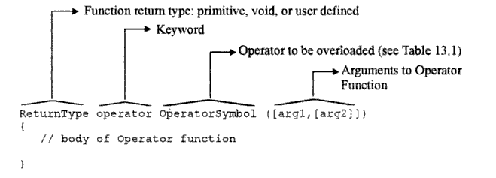
Unary operator overloading

Slide 4
++ operator overloading with member function
class A{
int a;
public:
A(int x):a(x){}
A operator ++(){return A(++a);}
A operator ++(int){return A(a++);}
void show(){cout<<a<<endl;}
};

Slide 5
Contd…
int main(){
A obj(10);
A obj2=++obj;
obj2.show();
obj.show();
A obj3=obj++;
obj3.show();
obj.show();
return 0;}
Output:
11
11
11
12

Slide 6
++ operator overloading with friend function
class A{
int a;
public:
A(int x):a(x){}
friend A operator ++(A & obj){return A(++obj.a);}
friend A operator ++(A & obj,int){return A(obj.a++);}
void show(){cout<<a<<endl;}
};

Slide 7
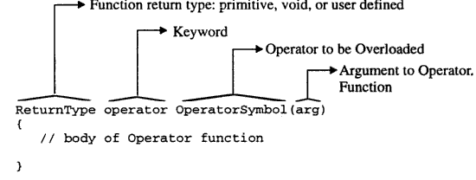
Binary operator overloading

Slide 8
+ operator via friend
class A{
int a;
public:
A(int x):a(x){}
friend A operator +(A obj1, A obj2){return A(obj1.a+obj2.a);}
void show(){cout<<a<<endl;}
};

Slide 9
+ operator via member
class A{
int a;
public:
A(int x):a(x){}
A operator +(A obj2){return A(a+obj2.a);}
void show(){cout<<a<<endl;}
};

Slide 10
Difference between two calls
+ Operator overloading by friend function:
Complex1+Complex2, the call looks like
operator +(Complex1,Complex2)
+ Operator overloading by member function:
Complex1+Complex2, the call looks like
Complex1.operator +(Complex2)

Slide 11
Exceptions
[], (), ->, = cannot be overloaded with friend function
When constants and objects need to be two operands respectively then friend function must be used, i.e. 7+object, 10* object etc
::, .*,. ,sizeof()And ?: cannot be overloaded. Why? Read
https://www.stroustrup.com/bs_faq2.html#overload-dot

Slide 12
= operator overloading
#include<iostream>
using namespace std;
class Test
{
int *ptr;
public:
Test (int i = 0) { ptr = new int(i); }
void setValue (int i) { *ptr = i; }
void operator=(Test obj){ *ptr=*obj.ptr;}//otherwise result will be 10
void print() { cout << *ptr << endl; }
};

Slide 13
Contd..
int main()
{
Test t1(5);
Test t2;
t2 = t1;
t1.setValue(10);
t2.print();
return 0;
}

Slide 14
->operator overloading
class Test
{
int r;
public:
Test (int i = 0) { r = i; }
Test * operator->(){ return this;}
void print() { cout << r << endl; }
};

Slide 15
Contd..
int main()
{
Test t1(5);
t1->print();
return 0;
}

Slide 16
() overloading
#include<iostream>
using namespace std;
class op{ //functor
int counter=0;
public:
int operator()(int num){return counter+=num;}
};
int main()
{
op obj;
cout<<obj(10)<<endl;//functor
cout<<obj(20);
return 0;
}

Slide 17
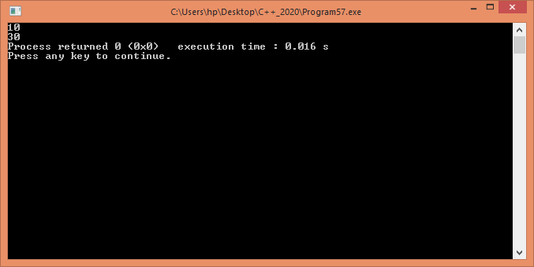
Output

Slide 18
new and delete operator overloading
If these operators are overloaded using member function for a class, it means that these operators are overloaded only for that specific class.
If overloading is done outside a class (i.e. it is not a member function of a class), the overloaded ‘new’ and ‘delete’ will be called anytime you make use of these operators (within classes or outside classes). This is global overloading.

Slide 19
Advantages
new and delete to do something customized that the compiler-provided versions don’t offer. For example, You might write a custom operator delete that overwrites deallocated memory with zeros in order to increase the security of application data.
Exception handling routine can be added in overloaded new operator function.
The overloaded new operator function can accept arguments; therefore, a class can have multiple overloaded new operator functions. This gives the programmer more flexibility in customizing memory allocation for objects.

Slide 20
Advantages
Overloaded new operator also enables programmers to squeeze some extra performance out of their programs.
For example, In a class, to speed up the allocation of new nodes, a list of deleted nodes is maintained so that their memory can be reused when new nodes are allocated.
In this case, the overloaded delete operator will add nodes to the list of deleted nodes and the overloaded new operator will allocate memory from this list rather than from the heap to speedup memory allocation.
Memory from the heap can be used when the list of deleted nodes is empty.
Source: https://www.geeksforgeeks.org/overloading-new-delete-operator-c/

Slide 21
Syntax for overloading the new operator
void* operator new(size_t size);
size_t, which specifies the number of bytes of memory to be allocated.
The return type of the overloaded new must be void*.
The overloaded function returns a pointer to the beginning of the block of memory allocated.

Slide 22
Syntax for delete operator overloading
void operator delete(void*);
The function receives a parameter of type void* which has to be deleted.
Function should not return anything.
Both overloaded new and delete operator functions are static members by default. Therefore, they don’t have access to this pointer .
You cannot refer any instance variable directly inside these function.

Slide 23
Program 1
#include<iostream>
#include<cstdlib>
int s_global= 5;
using namespace std;
class student
{
string name;int s;
int *a;
public:
student()
{
cout<< "Constructor is called\n" ;
}
student(string name){
cout<<"inside cons name"<<endl;
this->name=name;
cout<<"Enter values"<<endl;
for(int i=0;i<this->s;i++)
cin>>a[i];
}

Slide 24
Contd..
student(string name, int s)
{ cout<<"inside cons name, s"<<endl;
this->name = name;
this->s=s;
cout<<"Enter values"<<endl;
for(int i=0;i<this->s;i++)
cin>>a[i];
}
void display()
{
cout<< "Name:" << name << endl;
for(int i=0;i<s;i++)
cout<< a[i] <<" "<< endl;
}

Slide 25
Contd..
void * operator new(size_t size)
{
cout<< "Overloading new operator with size: " << size << endl;
void * p = ::new student;
//void * p = malloc(size); will also work fine
student *t=(student*)p;
t->a= new int[s_global];
return p;
}

Slide 26
Contd..
void * operator new(size_t size, int s)
{
cout<< "Overloading new operator with size and int: " << size <<" "<<s<< endl;
void * p = ::new student;
//void * p = malloc(size); will also work fine
student *t=(student*)p;
t->s=s;
t->a= new int[t->s];
return p;
}

Slide 27
Contd..
void operator delete(void * p)
{
cout<< "Overloading delete operator " << endl;
student *t=(student*)p;
delete t->a;
//free(p);
::delete p;
}
~student(){cout<<"destructor is called"<<endl;}
};

Slide 28
Contd..
int main()
{
student * p = new student("Yash", 5);
p->display();
delete p;
}

Slide 29
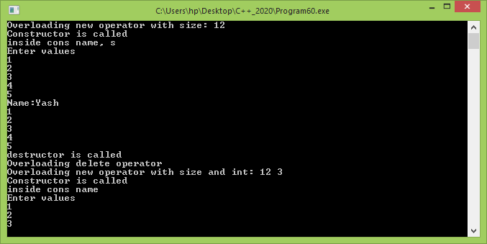
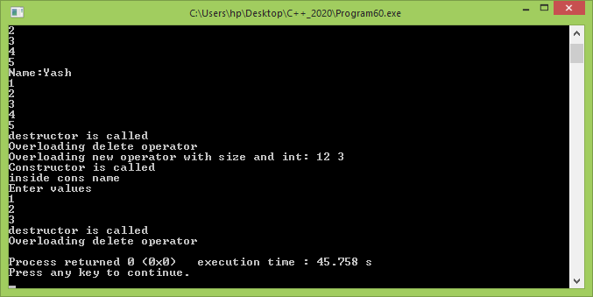
Output

